Slide 1

-1-

Slide 2

Business Case Study
TEAM: SKAM
SHARLENE WADHWA
KRISHNNA SARRDAH
ADITYA KHAIRE
MAURVIN SHAH
-2-

Slide 3
TO FIND:
Where are the best opportunities for Chem-X?
To prepare a chart for the number of Chem-X Vaccine distribution across the top 5 states.
The optimal pricing for the vaccine?
The optimal marketing and finance plan ?
-3-

Slide 4
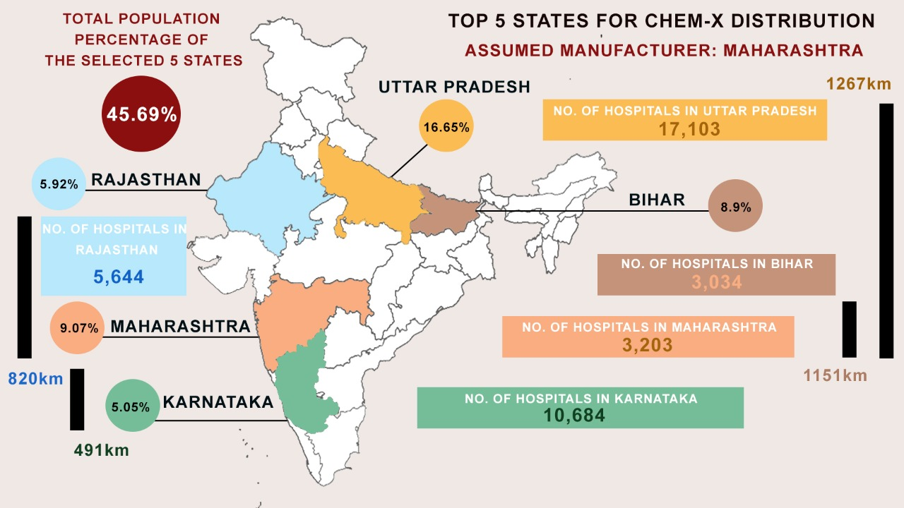
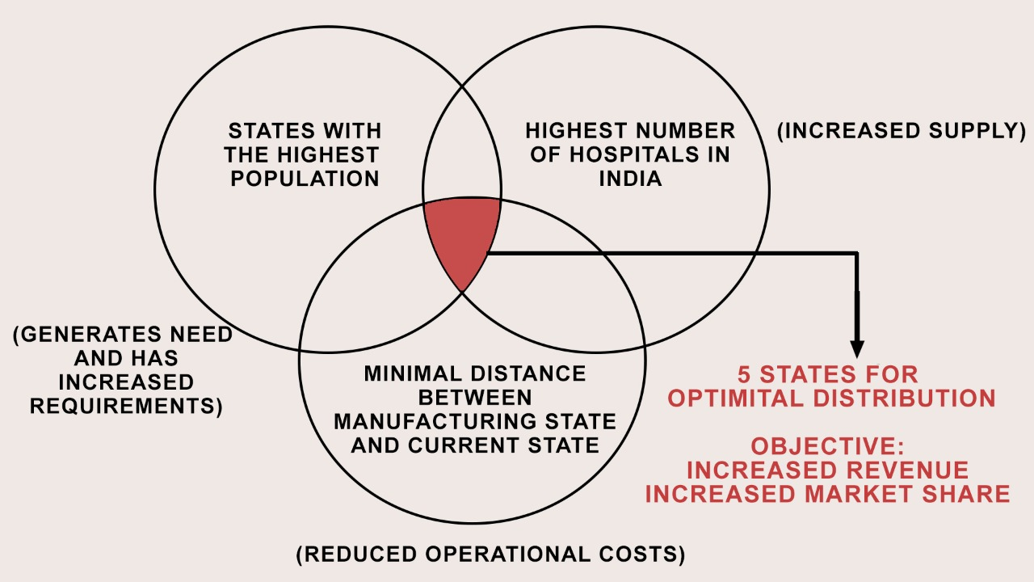
SOLUTION 1
TOP 5 STATES FOR DISTRIBUTION OF CHEM-X Vaccine
-4-

Slide 5
SOLUTION 1
STRATEGY TO TARGET 5 STATES FOR OPTIMAL DISTRIBUTION AND INCREASED REVENUE
SUPPLY AND DEMAND
States having a higher population plus increased rising covid-19 cases offer themselves as a higher consumer market for vaccine distribution. (They generate a demand and the need for supply)
TRANSPORTATION AND LOGISTICS
The States must be related in such a way that the distance amongst them is optimal and the costs for transportation is minimal. This will in turn contribute to reduced operational costs.
With the presence of a high number of hospitals we can use intra state routes between hospitals making it easier and more profitable and productive.
SECURITY AND DISTRIBUTION
It is crucial to focus on reducing Operational costs, Chem-X can use technologies such as Blockchain to make sure that the vaccines are monitored from the place of production to the area of distribution. It offers increased efficiency by transferring transactions online and increasing transparency, therefore decreasing the chances of fraud.
-5-

Slide 6

SOLUTION 1
MAHARASHTRA
Maharashtra accounts for 9.07% of the population in India.
Since it lies in the center of the selected 5 states, we can assume it to be the manufacturing center for the Chem-X vaccine due to its geographical reach.
Considering Maharashtra to be the center of operations, the logistics prove to be more efficient as the result of cheap and easily available labour due to the high population of the state (12.62 crore).
NO. OF HOSPITALS IN
PUBLIC SECTOR
711
NO. OF HOSPITALS IN
PRIVATE SECTOR
2,492
Due to the high and rising number of coronavirus cases, a high demand is created, hence a high supply is required which in turn increases the market share of Chem-X and its revenue simultaneously
The city of Mumbai has access to multiple ports and harbours, hence the import of raw materials for production vaccine will be cheaper and will hence account for reduction in operational cost.
Pune is the IT hub of Maharashtra and can ensure secure transportation and easy supply chain management through IOT and Blockchain.
(Use of technology reduces operational cost)
-6-

Slide 7


SOLUTION 1
UTTAR PRADESH
RAJASTHAN
Rajasthan accounts for the largest state population in India at 5.92%.
It plays in an important role in logistics as 40% of cargo and shipment passes through the state which proves to be an advantage.
Uttar Pradesh accounts for the largest state population in India at 16.65%.
They are also home to the highest number of hospitals in both the private and public sector this translates to an immediate need for the vaccine, due to the states high requirement, the increased demand will need a larger rate of supply, resulting in profits.
6 economic corridors pass through the state and multi-modal integrated transport and logistics benefits to a great extent.
NO. OF HOSPITALS IN PUBLIC SECTOR
2,850
NO. OF HOSPITALS IN PRIVATE SECTOR
2,794
NO. OF HOSPITALS IN
PUBLIC SECTOR
4,635
NO. OF HOSPITALS IN
PRIVATE SECTOR
12,468
-7-

Slide 8

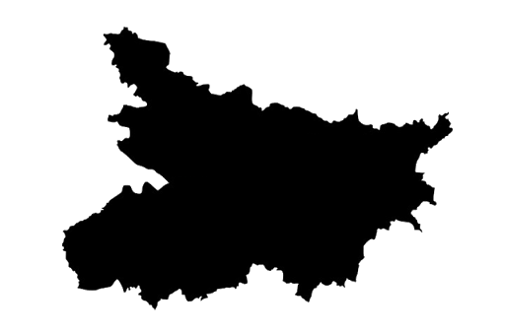
SOLUTION 1
KARNATAKA
BIHAR
Karnataka accounts for 5.05% of the population in India.
NO. OF HOSPITALS IN
PUBLIC SECTOR
2,842
NO. OF HOSPITALS IN
PRIVATE SECTOR
7,842
Bihar accounts for the bulk of 8.9% of the population in India.
It is known for its well established medical industry. It alone accounts for 10,000 hospitals in the country. With this aggregate there is a high demand created for the vaccines as supply would escalate.
Bihar’s massive population and distance from
the manufacturing center make it another ideal
state in comparison to other states such as
Kerala and Tamil Nadu, hence reducing operational costs and therefore contributing to an uncompromised growth in revenue and market share.
Therefore increasing the probability of generating high revenue and hence market share.
The Kempegowda international airport cargo facilities are equipped to handle the storage and distribution of the covid-19 vaccines. This alone accounts to 13%of international cargo increasing the ease of international export.
NO. OF HOSPITALS IN
PUBLIC SECTOR
1,147
NO. OF HOSPITALS IN
PRIVATE SECTOR
1,887
-8-

Slide 9
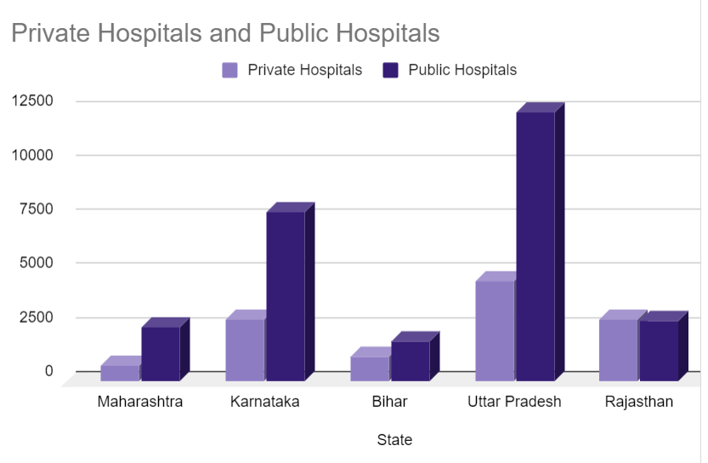
SOLUTION 2
We aim to distribute the vaccines amongst the selected 5 states based on the number of hospitals they have, and not the population. This would avoid unnecessary additional costs of cold storing the vaccines in the states which higher population but lower hospital count.
Assuming we are manufacturing 4 lakh vaccines per day, Hence considering 24 working days in a month we would manufacture 96 lakh vaccines per month.
DISTRIBUTION OF PRIVATE AND PUBLIC HOSPITALS
-9-

Slide 10
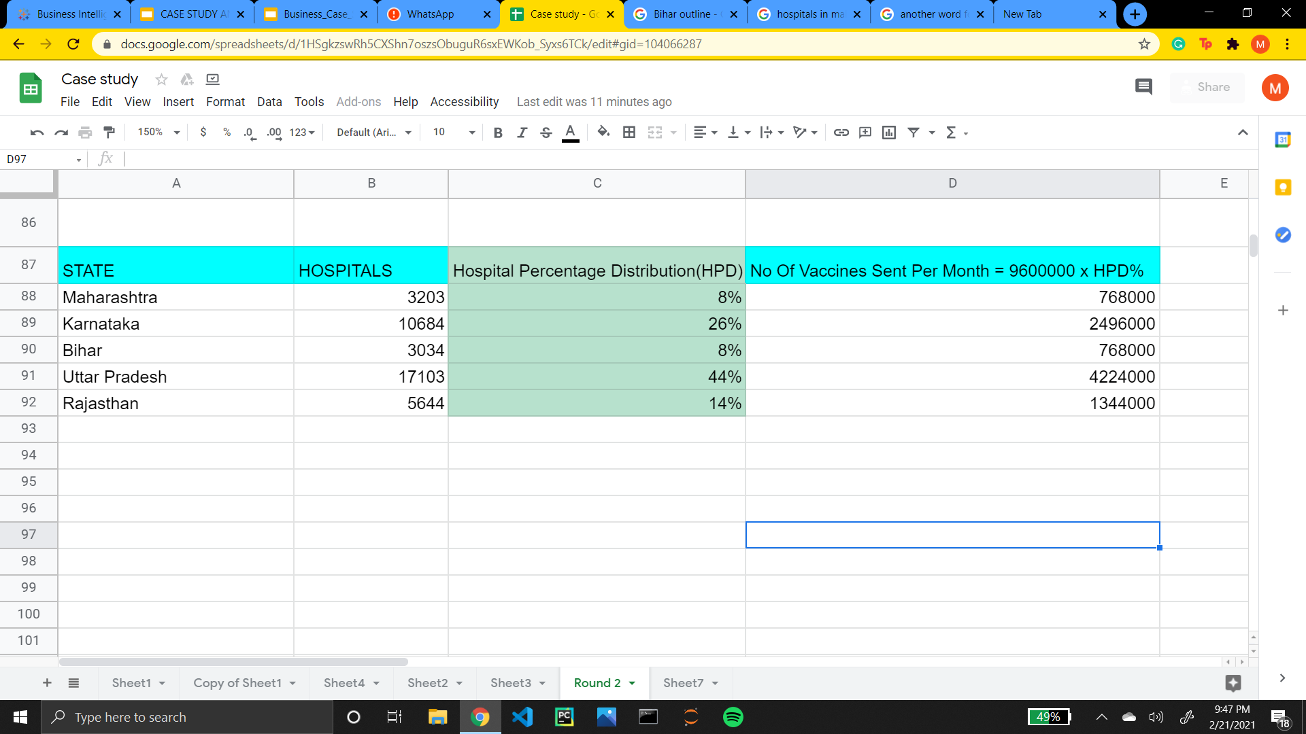
SOLUTION 2
From the given table, we have calculated the hopsital percentage distribution
= Hospitals in a state/Total Number of hospitals in 5 states
Therefore the Number of vaccines distributed to each state per month can be calculated using
= No. of vaccines produced in one month x Hospital percentage distribution
= 96 lakh vaccines per month x Hospital percentage distribution
Therefore on calculation we get the above values.
-10-

Slide 11
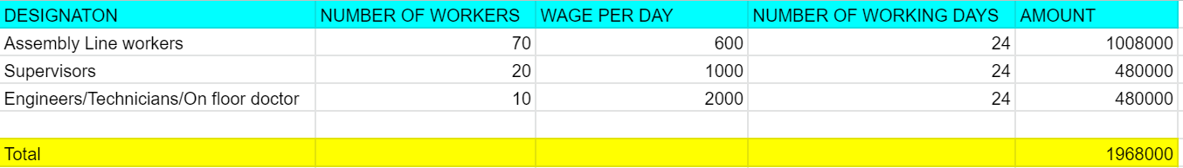
SOLUTION 3
FINDING THE OPTIMAL PRICE FOR THE VACCINE PRODUCED BY CHEM-X
Approach used : Guestimation
The manufacturing plant considered is in Maharashtra, all presumptions, rates are based on the average costs in the above mentioned state.
LABOUR
Assuming the Labour strength to be 100 distributed in the following format
Therefore the Labour costs calculated would be 1968000 (INR)
-11-

Slide 12
SOLUTION 3
2. RENT
Assuming the manufacturing plant is of 1 acre near Pune, Maharashtra, has a monthly rent of Rs 15 per square feet (Presumption based on average real estate rate in Pune)
1 acre = 43560 square feet
Therefore Rent would be = 43560 x 15
= 653,400 INR per month
3. MAINTENANCE
Considering we have 8 assembly lines which account for manufacturing around 4 lakh vaccines per day.
Maintenance cost of each assembly line = 50,000 INR
Therefore total monthly cost of maintenance would be = 8 x 50,000
= 400,000 INR per month
4. RAW MATERIALS
The basic raw materials for manufacturing a vaccine include active ingredients, Lipids, Salts and Other chemicals. The average rate of a chemical ingredient in India costs 70 Rs per litre
Assuming we are manufacturing 4 lakh vaccines per day and given 24 working days in a month we would manufacture 96 lakh vaccines per month. Each vaccine vile is 0.5ml hence 96 lakh such viles would account to 4,800 litres. Based on the average chemical rates, our raw material costs would be approximately
70 x 4 x 4800 = 1344000 INR per month
-12-

Slide 13
SOLUTION 3
5. ELECTRICITY COST
Electricity rate in Pune is Rs 9 per unit. On an average manufacturing plants consume 9,000 units of electricity per month.
Hence our electricity cost will be = 9 x 9000
= 81,000 INR per month
6. PACKAGING COST
Vinyl bottles are sold for Rs 0.5 per unit
Syringes are sold at Rs 0.5 per unit
Assuming packaging costs per vinyl bottle to be Rs 1, hence the packaging cost for 96 lakh vaccines would be
(0.5 + 0.5 + 1) x 96 lakh = 192,00,000 INR per month
7. COLD STORAGE
Amount of vaccines produced per day = 4 lakh
Cost of storing 4 lakh vaccines in cold storage = 15,000 per day (value generated from online resources)
Hence storing them over a period of one month would be = 30 x 15,000
= 450,000 INR per month
-13-

Slide 14
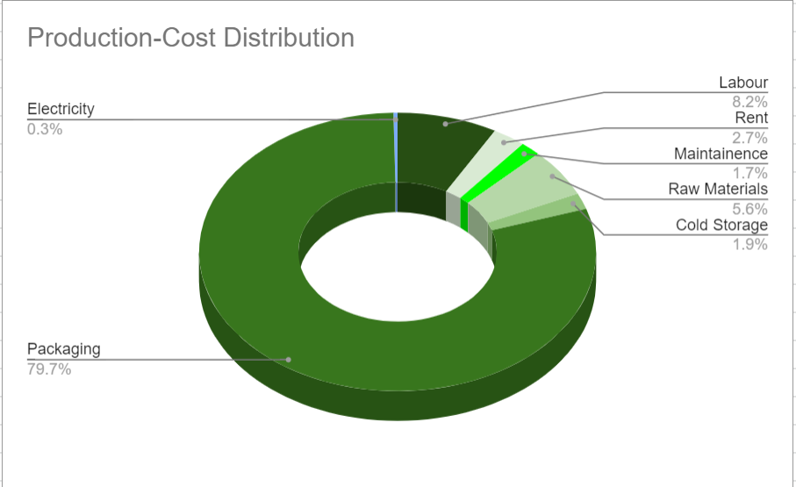
SOLUTION 3
FROM THE ABOVE CALCULATION, WE INFER THE FOLLOWING DIAGRAM
-14-

Slide 15
SOLUTION3 3
Logistics Calculations
According to the cold packing and logistics company COLD CHAIN TECHNOLOGIES, they charge the following :
Rs. 25,000 for first 200 km after that Rs 30 for the rest of the kms. per tonne Storage.
We use the following formula to calculate the transport charges per State.
Formula = Cost = 25000 x (Distance from Maharashtra - 200) x 30 x Weight in tonne
-15-

Slide 16
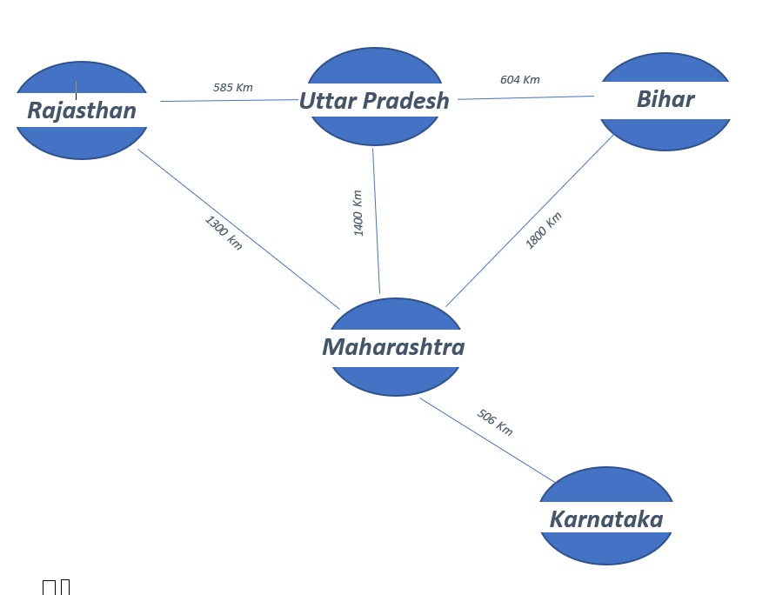
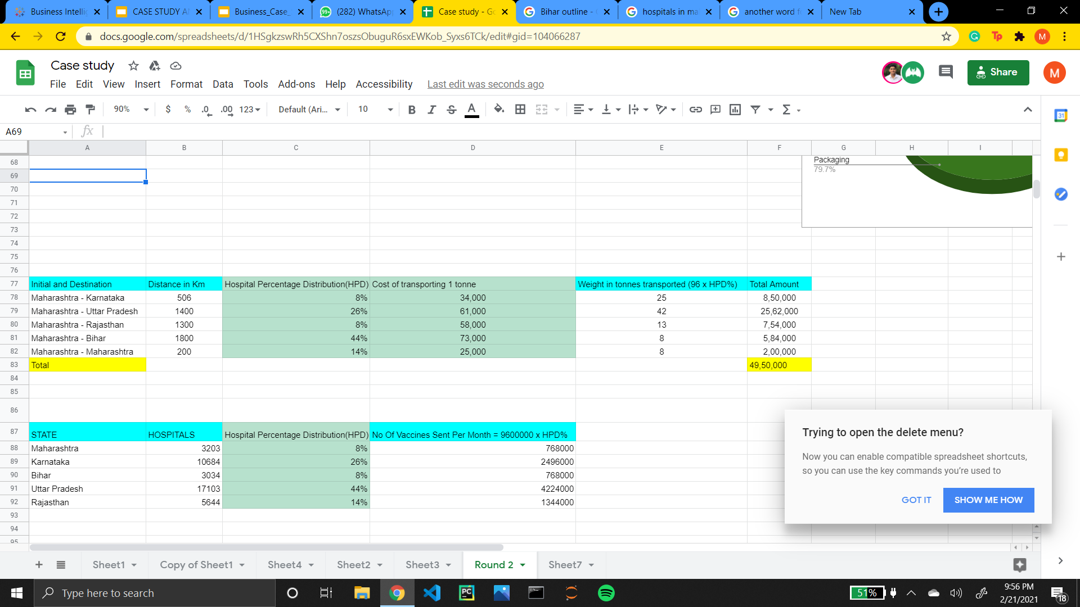
SOLUTION 3
Logistics Cost Calculations
-16-

Slide 17
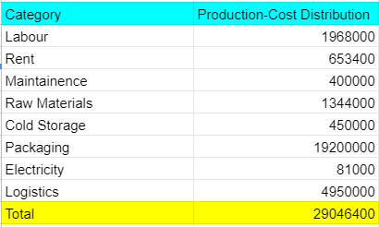
SOLUTION 3
Therefore total cost to make 96,00,000 vaccines including logistics would be 290,46,400/96,00,000 ≈ 4 Rs per vile
Hence we can afford to set an optimal price of the vaccine for INR 600 which is less than the price of competitors offer,
Considering we made have made a prior investment of (100 million USD) 725,00,00,000 (INR Number Based on Serum Institute’s Investment amount)
Revenue per Month = 96,00,000 x 600 = 567,00,00,000 INR
Hence we Get a ROI and break even on our Investment within 2 months (Considering Ideal situations)
-17-

Slide 18

MARKETING PLAN
1. Reputation booster Campaigns.
2. Make Influencers spread the word.
3. Focusing on Population wellness than Personal Sickness.
4. Promote Vaccine acceptance which will trigger herd mentality.
Science will win!
-18-

Slide 19

FINANCE PLAN
Generation:
User Fees
Vaccine Funds & Cross Subsidies
Grants from Philanthropic Institutions
Health Insurance
Use:
1.Driving operations cost down to increase profitability
2. Advertisement & Marketing
-19-

